Slide 1

Challenge 4 - Finance Financial Analysis
STEEL DATA-CHALLENGE 4

Slide 2
INTRODUCTION
You are a Finance Analyst working for 'The Big Bank'
You have been tasked with finding out about your customers and their banking behaviour. Examine the accounts they hold and the type of transactions they make to develop greater insight into your customers.

Slide 3
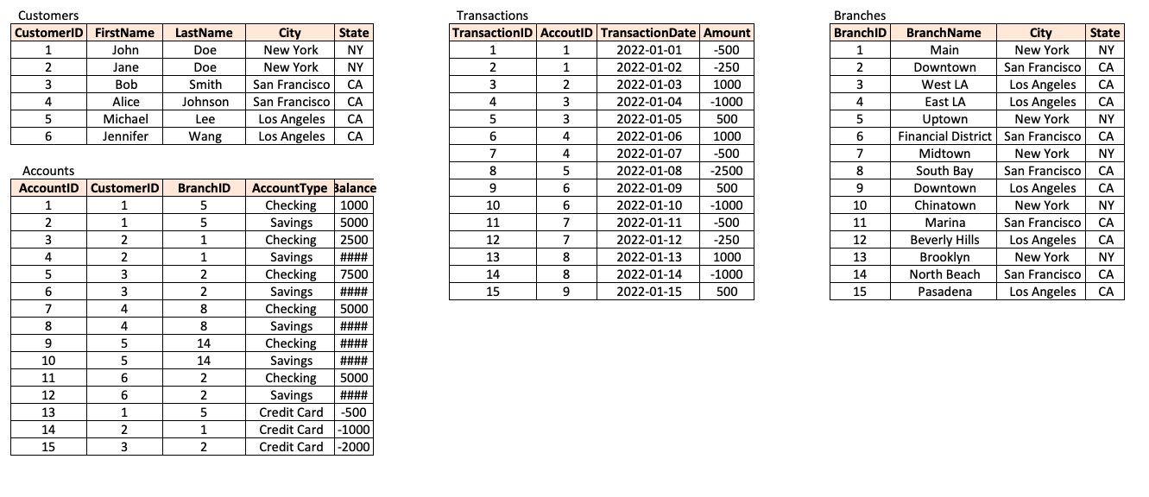
Tables Here are the tables you will be using

Slide 4
--1. What are the names of all the customers who live in New York?
SELECT CONCAT(FirstName,LastName) as CustomerName
FROM DACORNER..Customers
WHERE City='New York'
ORDER BY 1
CustomerName
JaneDoe
JohnDoe
--2. What is the total number of accounts in the Accounts table?
SELECT COUNT(*) AS NumberofAccounts
FROM DACORNER..Accounts
NumberofAccounts
15

Slide 5
--3. What is the total balance of all checking accounts?
SELECT AccountType,SUM(Balance) as TotalBalance
FROM DACORNER..Accounts
WHERE AccountType='Checking'
GROUP BY AccountType
AccountType TotalBalance
Checking 31000.00
--4. What is the total balance of all accounts associated with customers who live in Los Angeles?
SELECT SUM(Balance) as TotalBalanceLA
FROM DACORNER..Accounts A
LEFT JOIN DACORNER..Customers C
on A.CustomerID=C.CustomerID
WHERE C.City='Los Angeles’
TotalBalanceLA
75000.00

Slide 6
--5. Which branch has the highest average account balance?
SELECT TOP 1 A.BranchID,BranchName,AVG(Balance) as AvgBalance
FROM DACORNER..Accounts A
LEFT JOIN DACORNER..Branches B
on A.BranchID=B.BranchID
GROUP BY BranchName,A.BranchID
ORDER BY AvgBalance DESC
BranchID BranchName AvgBalance
North Beach 30000.000000
--6. Which customer has the highest current balance in their accounts?
SELECT top 1 C.CustomerID,FirstName,
SUM(A.Balance) as TotalBalanceCustomer
FROM DACORNER..Accounts A
JOIN DACORNER..Customers C
on A.CustomerID=C.CustomerID
GROUP BY C.CustomerID,FirstName
ORDER BY TotalBalanceCustomer DESC
CustomerID FirstName TotalBalanceCustomer
5 Michael 60000.00

Slide 7
--7. Which customer has made the most transactions in the Transactions table?
SELECT C.CustomerID,FirstName,LastName, COUNT(TransactionID) AS NumerOfTxn
FROM DACORNER..Transactions T
join DACORNER..Accounts A
on T.AccountID=A.AccountID
join DACORNER..Customers C
on A.CustomerID=C.CustomerID
GROUP BY C.CustomerID,FirstName,LastName
ORDER BY NumerOfTxn DESC
CustomerID FirstName LastName NumerOfTxn
2 Jane Doe 4
4 Alice Johnson 4
3 Bob Smith 3
1 John Doe 3
5 Michael Lee 1

Slide 8
--8.Which branch has the highest total balance across all of its accounts?
SELECT TOP 1 BranchName,SUM(Balance) AS TotalBranchBalance
FROM DACORNER..Accounts A
LEFT JOIN DACORNER..Branches B
on A.BranchID=B.BranchID
GROUP BY BranchName
ORDER BY TotalBranchBalance DESC
BranchName TotalBranchBalance
North Beach 60000.00
--9. Which customer has the highest total balance across all of their accounts, including savings and checking accounts?
SELECT TOP 1 A.CustomerID,FirstName,SUM(Balance)as CustomerTotalBalance
FROM DACORNER..Accounts A
JOIN DACORNER..Customers C
on A.CustomerID=C.CustomerID
GROUP BY A.CustomerID,FirstName
ORDER BY FirstName DESC
CustomerID FirstName CustomerTotalBalance
5 Michael 60000.00

Slide 9
--10. Which branch has the highest number of transactions in the Transactions table?
SELECT A.BranchID,BranchName,Count(BranchName) as NofTxn
FROM DACORNER..Transactions T
join DACORNER..Accounts A
on T.AccountID=A.AccountID
join DACORNER..Branches B
on A.BranchID=B.BranchID
GROUP BY A.BranchID,BranchName
ORDER BY NofTxn DESC
BranchID BranchName NofTxn
1 Main 4
8 South Bay 4
2 Downtown 3
5 Uptown 3
North Beach 1

Slide 10
THANK YOU

